Slide 1
1&2 JOHN

Slide 2
1&2 JOHN
2 John ~ 13 verses, 301 words
3 John ~ 14 verses, 296 words

Slide 3
1&2 JOHN
2 John
3 John
2 & 3 John “Wordles”

Slide 4
1&2 JOHN
"Controversy for the sake of controversy is a sin; but controversy for the sake of truth is a divine command"
Walter Martin

Slide 5
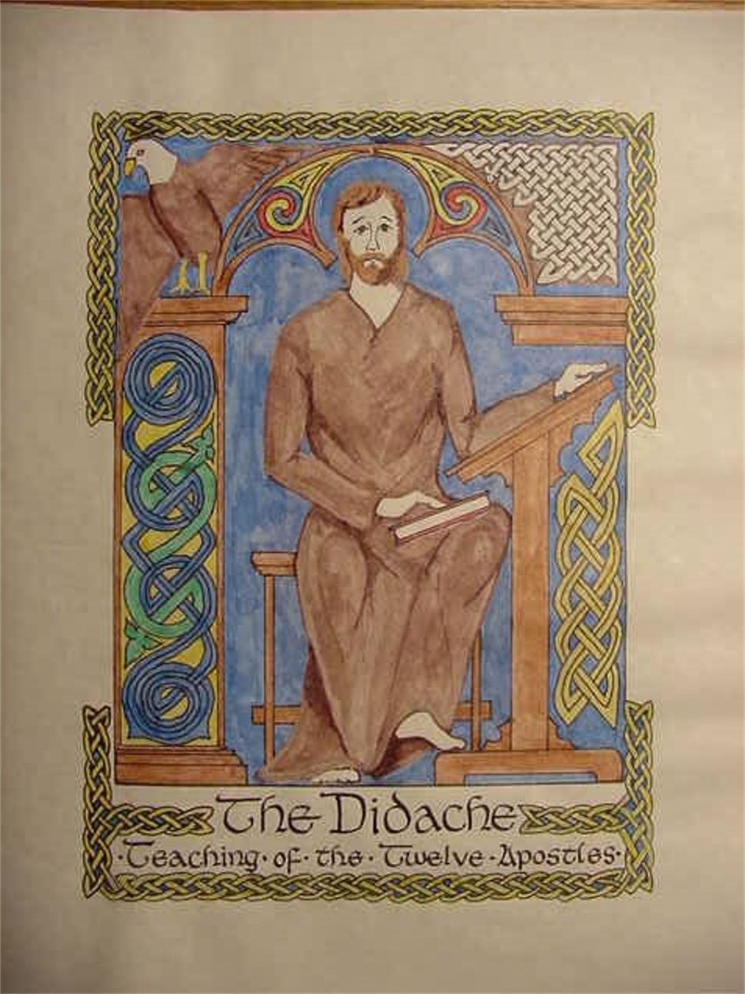
1&2 JOHN
The Didache, AD 80-120

Slide 6
1&2 JOHN
Lady ~ kuria
Feminine form of kurios (lord)

Slide 7
1&2 JOHN
For this is the love of God, that we keep His commandments. And His commandments are not burdensome.
agapaō = selflessness
1 John 5.3

Slide 8
1&2 JOHN
and every spirit that does not confess that Jesus Christ has come in the flesh is not of God. And this is the spirit of the Antichrist, which you have
heard was coming, and is
now already in the world.
as coming in the flesh ~ also correct: is coming in the flesh
1 John 4.3

Slide 9
1&2 JOHN
Transgresses ~ (NU) goes ahead
The man who is so "advanced" that he is not content with what Christ taught, has in fact
no God. The man who
bases his life on Christ’s teaching, however, has both
the Father and the Son.
Philips' N. T. in Modern English

Slide 10
1&2 JOHN
"To some modern minds these instructions seem unduly rigid and harsh. A great part of the problem, however, lies in the modern inclination to be highly
tolerant of religious differ-
ences. One must frankly face
the fact that the New Testa-
ment writers did not share
this spirit of toleration.
Their commitment to the
truth and their consciousness of
the dangers of religious error
called forth many stern denunciations of false teach-
ers. Not surprisingly, this
modern age, having a dimin-
ishing sense of the dangers of heresy, has lost its convic-
tions about the truth."
Bible Knowledge Commentary

Slide 11
1&2 JOHN
Gaius ~ Latin form of "Lord"

Slide 12
1&2 JOHN
"How healthy would your body be if it reflected the health of your soul?"
David Guzik

